Slide 1




DOUBLY LINKED LIST
& ITS APPLICATION

Slide 2



Presented to
MD. Hasan Al Banna
Lecturer

Slide 3





Our team
Shamoyeta Mourin Mouly
Latifa Nishat Nishi
Tahsina Tabassum Roza
Rajaya Rabby Ador
2252421036
2252421062
2252421084
2252421100

Slide 4
Contents
Introduction of DLL
Application of DLL
Creation of A Node
Insertion
Deletion
Print List
Search
Reverse

Slide 5

INTRODUCTION

Slide 6
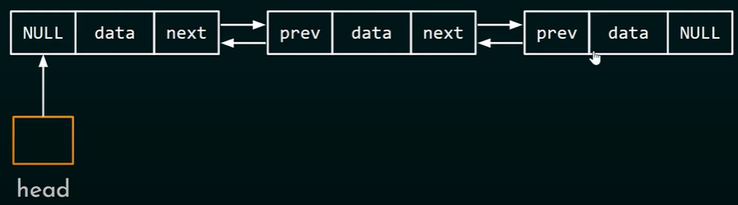
Doubly Linked List
Unlike singly linked list, doubly linked list can be traversed in both forward and backward directions because of the next and previous pointers.

Slide 7


Applications 0f Doubly linked list
Implementing Stacks and Queues
Undo/Redo Operations
Cache Memory Management
Music and Video Playlists
Browser History
Basic Task List

Slide 8

Basic Task List

Slide 9
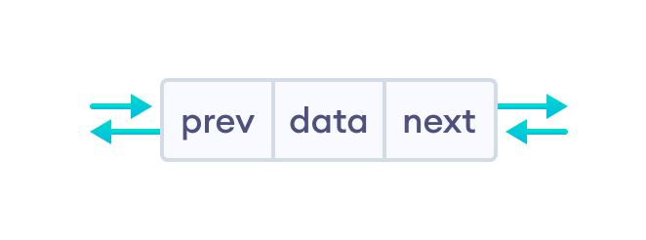
Creation of A Node
struct node {
int data;
struct node *next;
struct node *prev;
} ;
Node

Slide 10
INSERTION

Slide 11



INSERTION
1
Insertion at the Head
2
Insertion at a Position
3
Insertion at the End

Slide 12

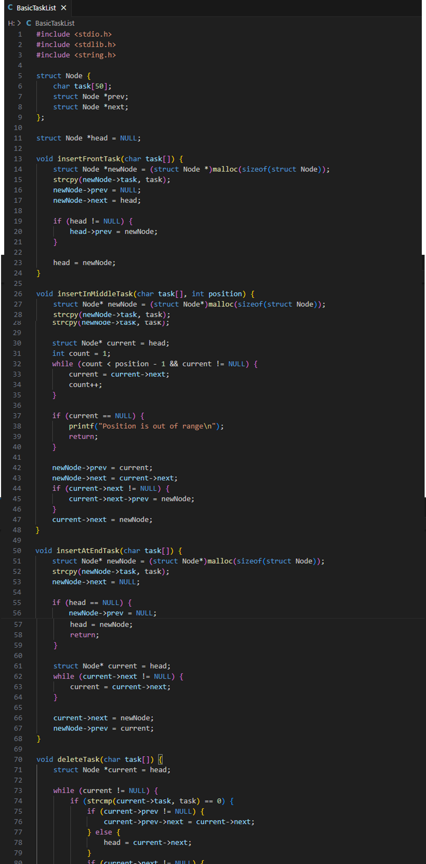
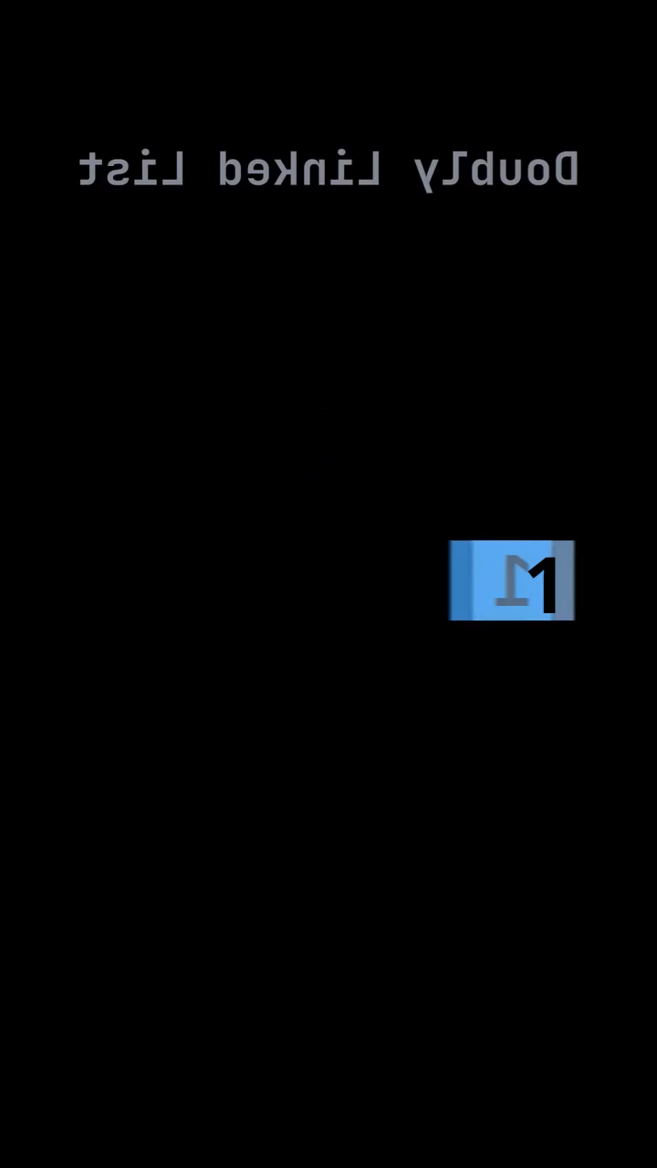
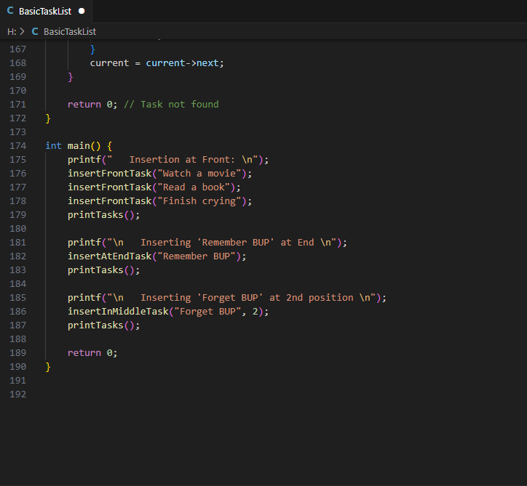
Application of DLL
(BASIC TASK LIST)
Simulation

Slide 13
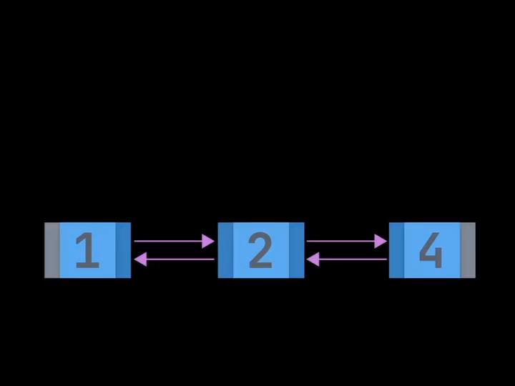

Slide 14
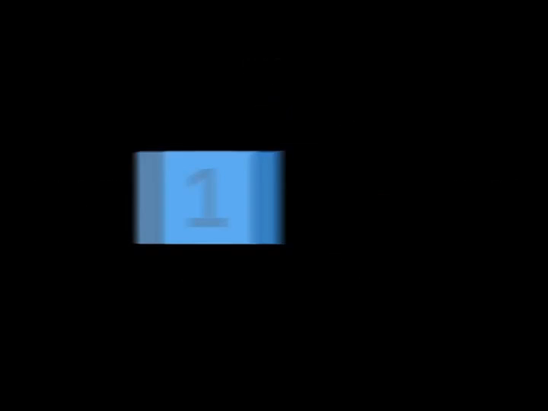

Slide 15


Slide 16
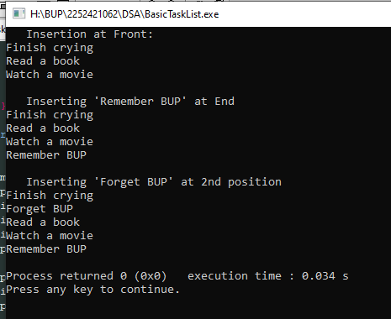

Slide 18
Deletion

Slide 19

Deletion
First node
Intermediate
node
Last node

Slide 20

Deletion at first node
HEAD
HEAD
NULL
Next
Prev
Next
Prev
NULL
TEMP
NULL

Slide 21
Deletion at last node
HEAD
NULL
NULL
Next
Prev
Next
Prev
NULL
TEMP
TEMP

Slide 22
Deletion intermediate node
HEAD
NULL
Next
Prev
Next
Prev
NULL
TEMP
TEMP
TEMP2

Slide 23
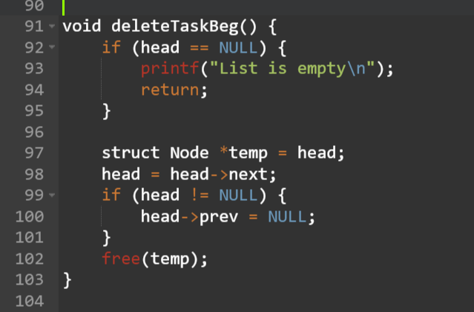
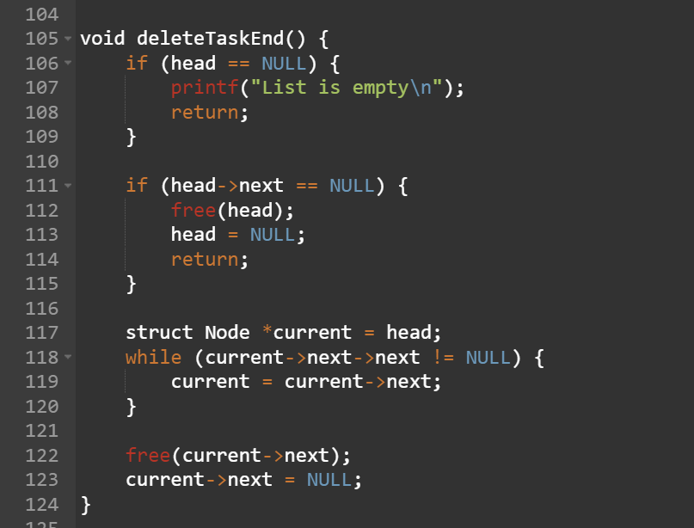
Code for delete at beginning
Code for delete at end

Slide 24
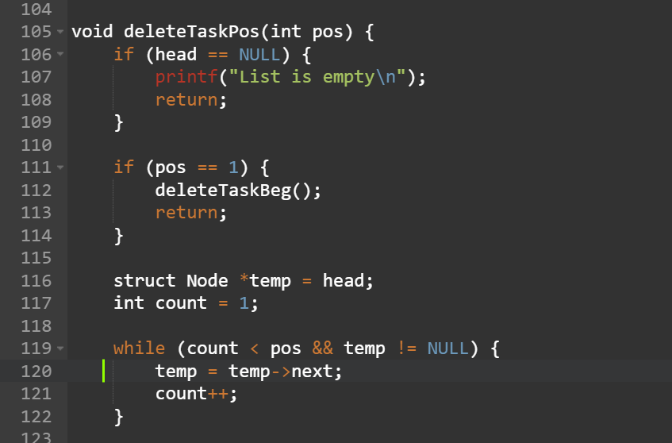
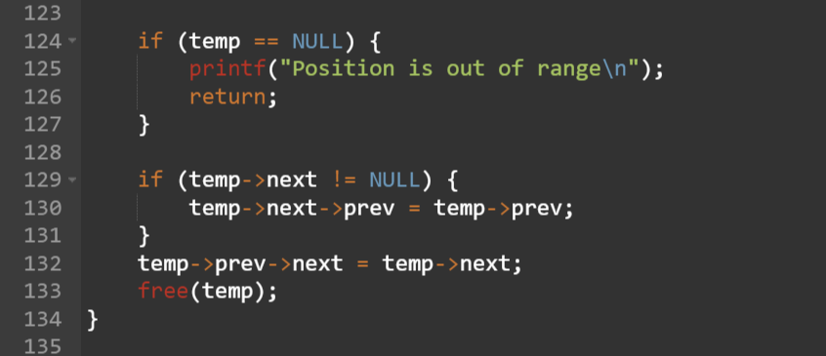
Code for deletion at a specific position

Slide 25
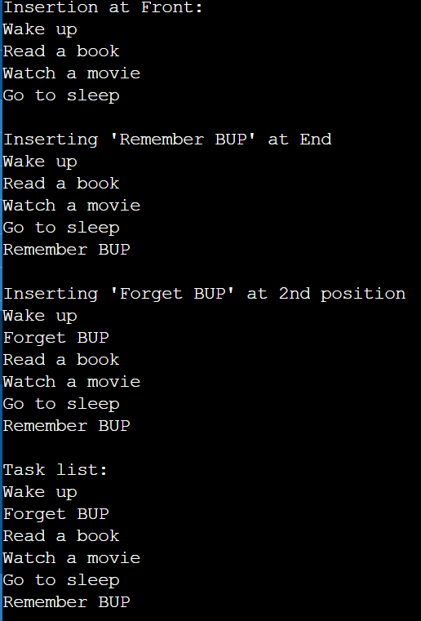
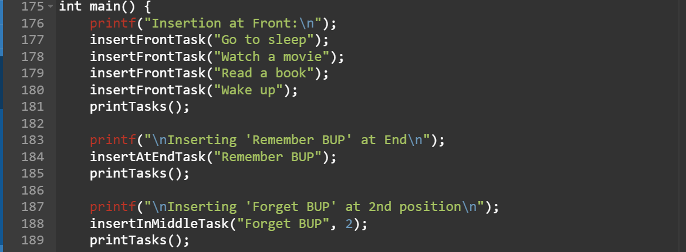
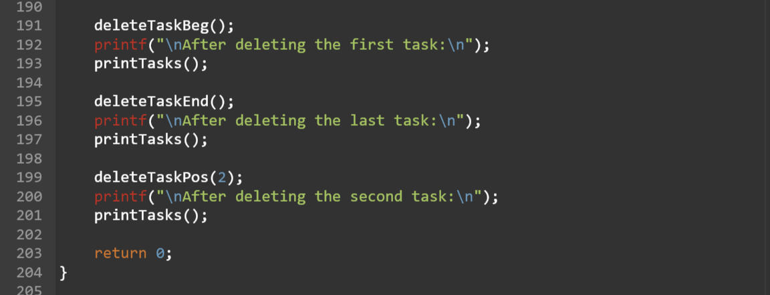
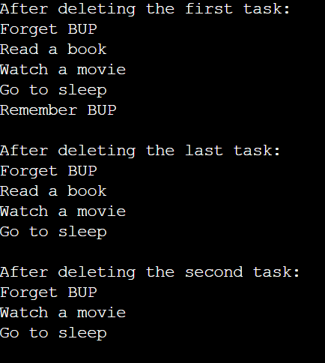
Output:
Main Function:

Slide 26
Print List

Slide 27
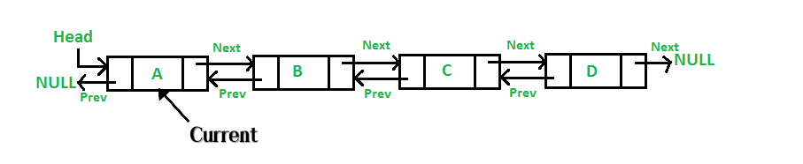
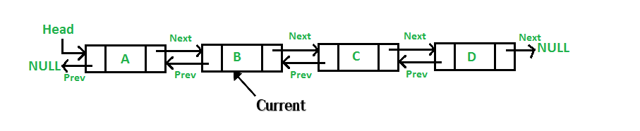
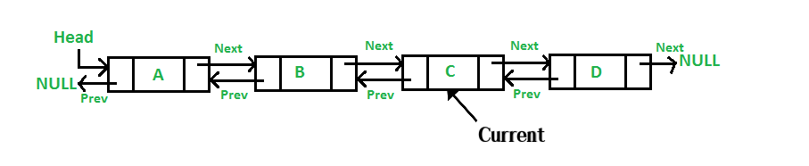
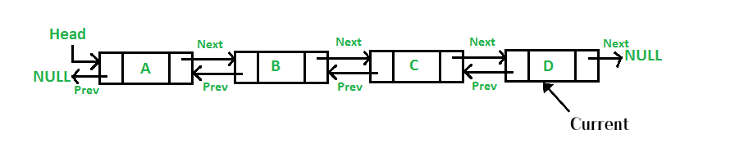
Print List
Iteration-01
Iteration-02
Iteration-03
Iteration-04

Slide 28
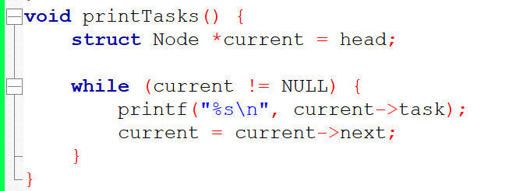
Code for Printing List

Slide 29
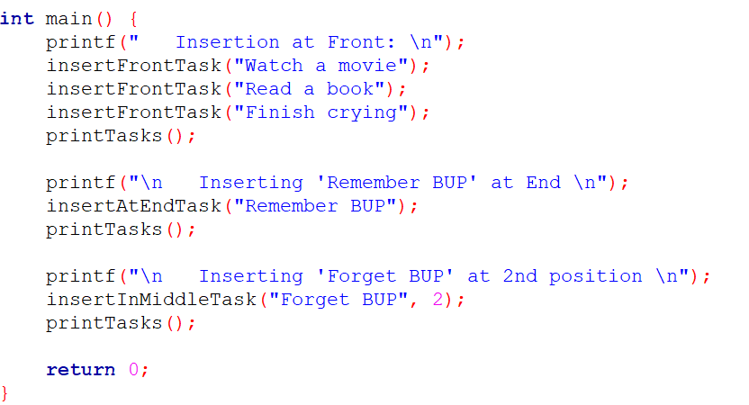
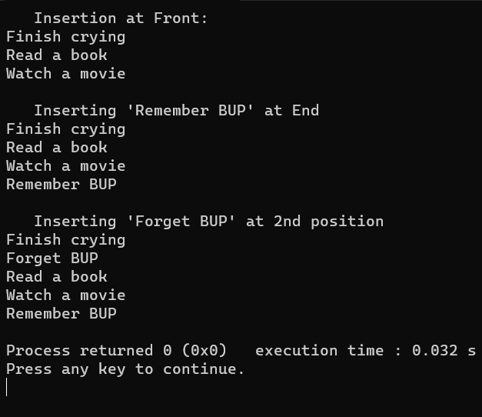
Code for Printing List
Main Function
Output

Slide 30
Search in Doubly Link List

Slide 31
Search in DLL
Iteration-01
Iteration-02
Iteration-03

Slide 32
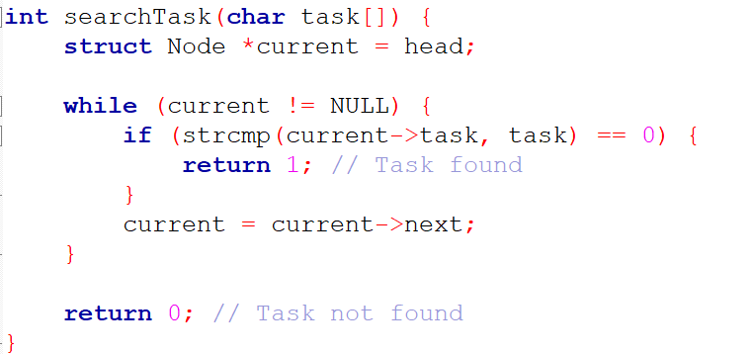
Code for Search

Slide 33
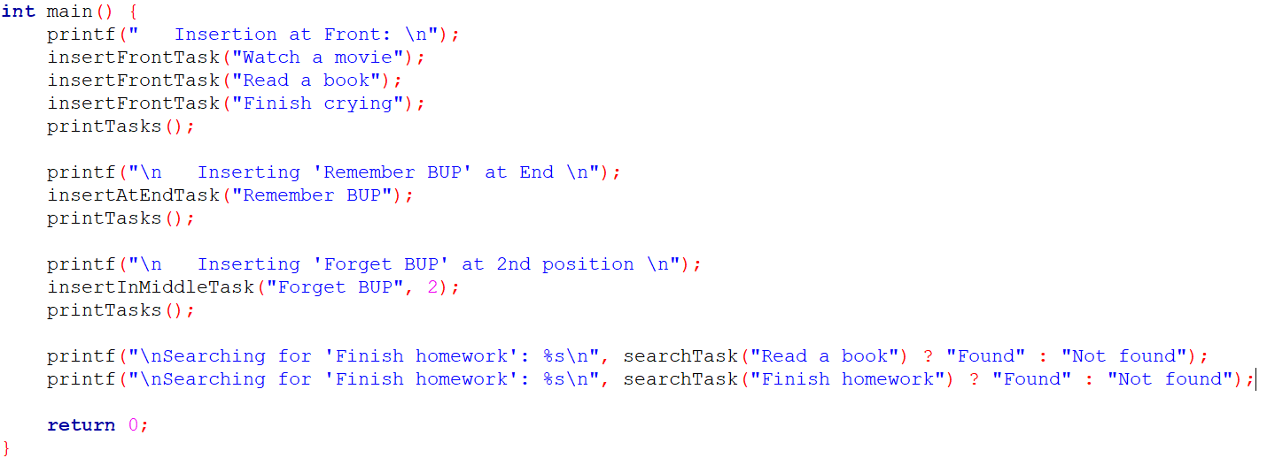
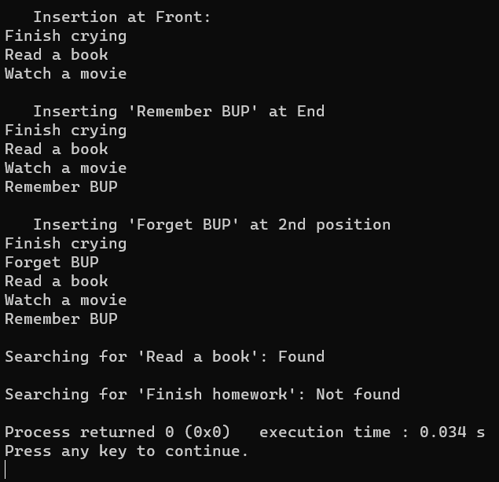
Code for Searching
Main Function
Output

Slide 34
Reverse Doubly Link List

Slide 35
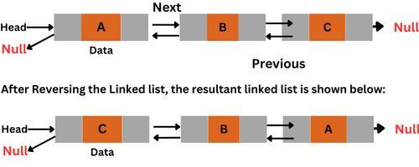
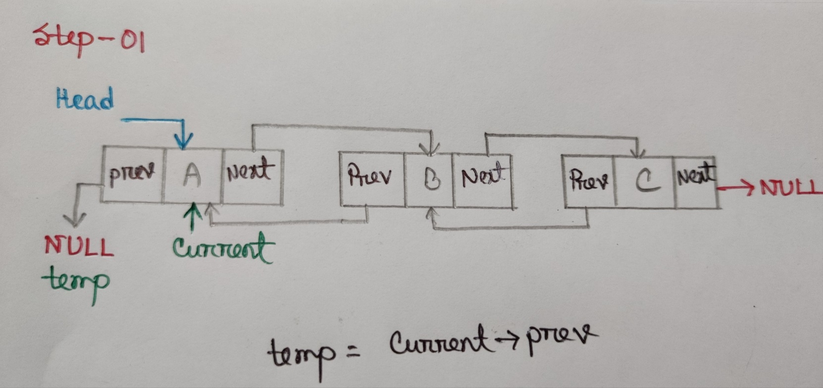
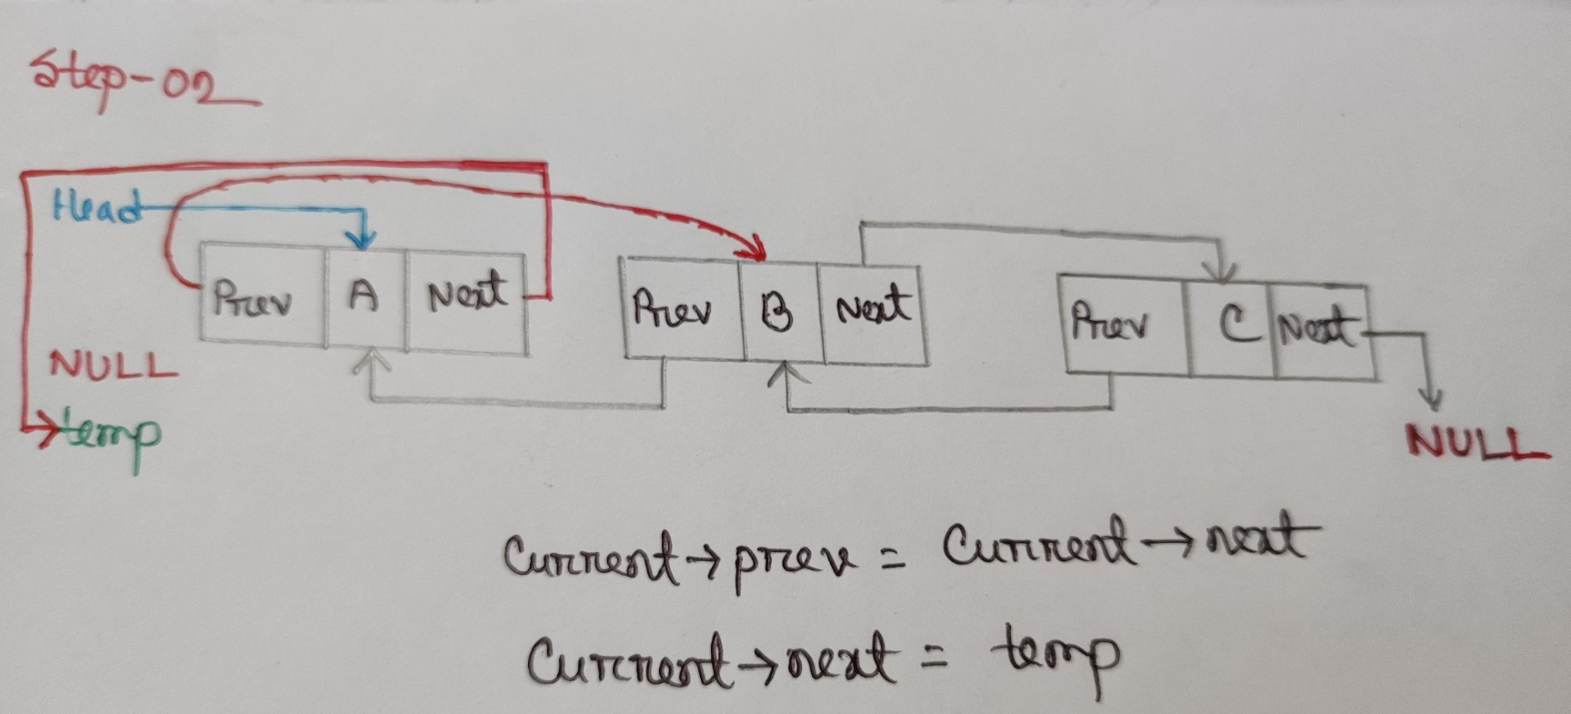
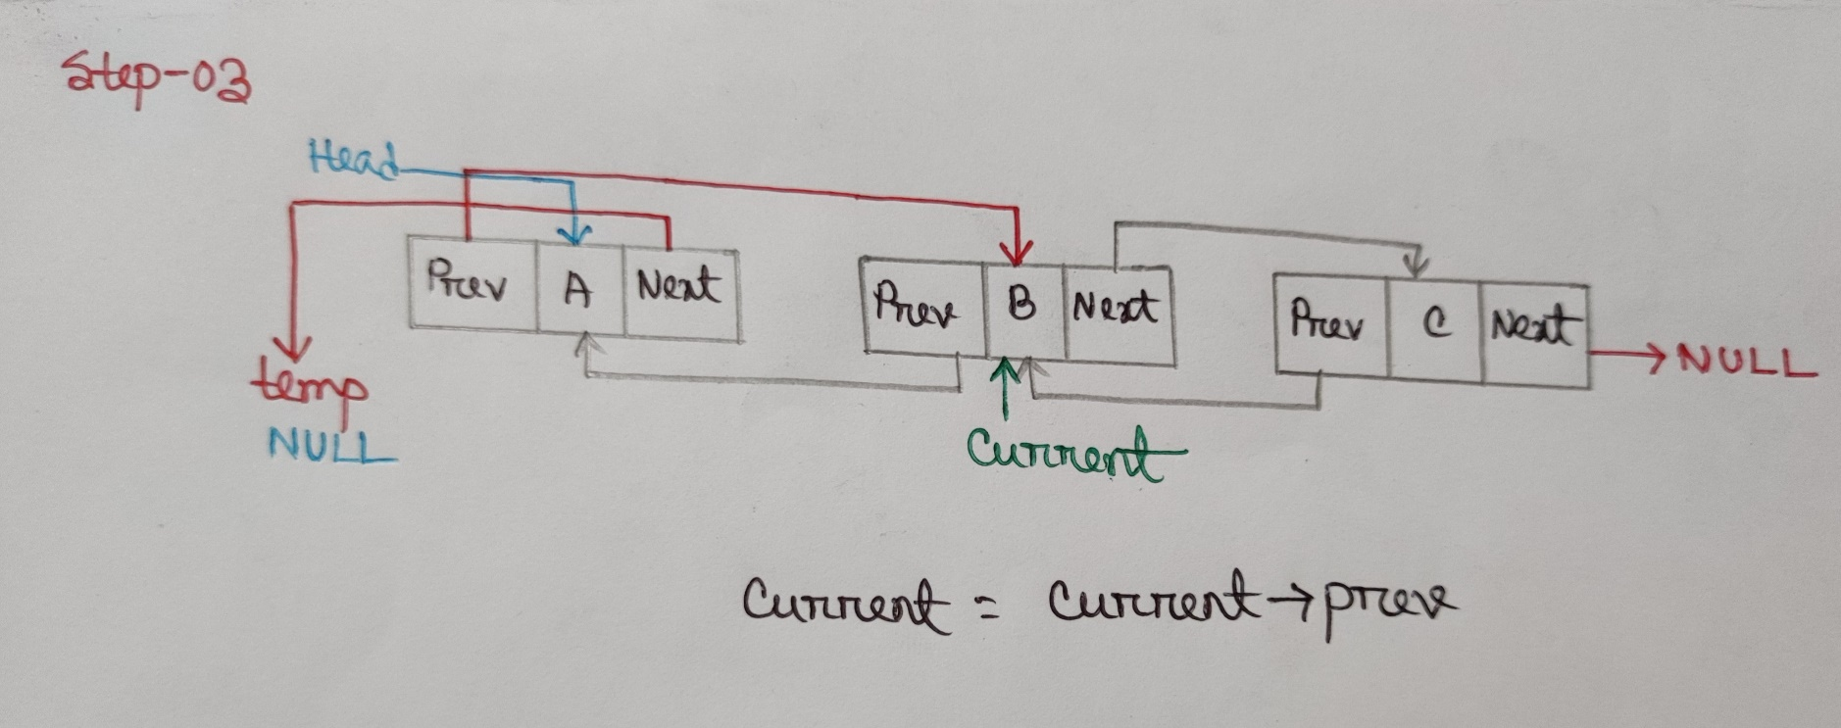
Reverse

Slide 36
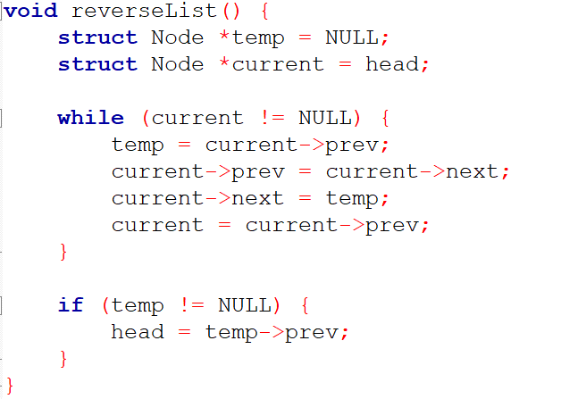
Code for Reversing List

Slide 37
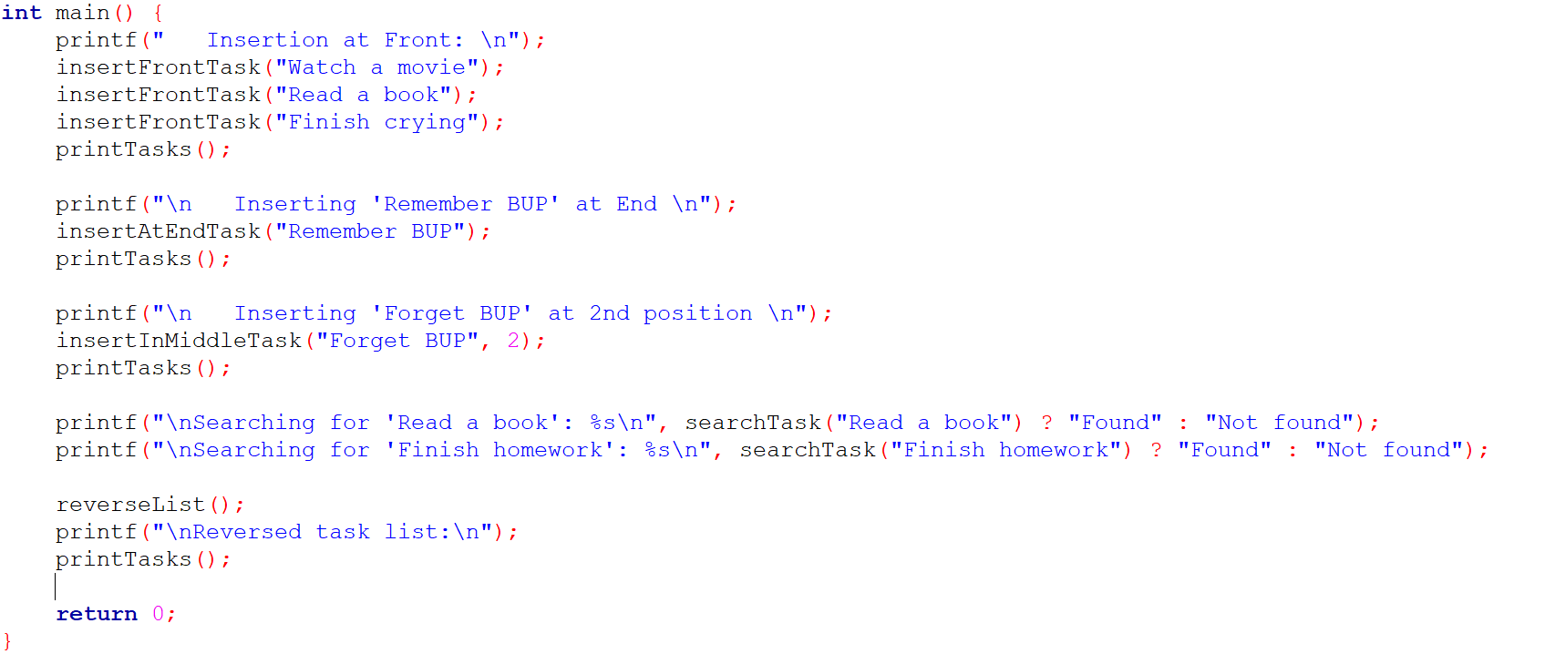
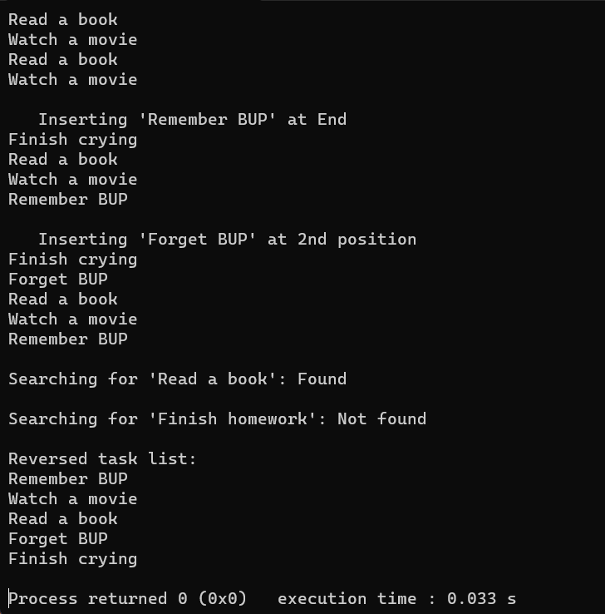
Code for Reversing
Main Function
Output

Slide 38
THANK YOU
For watching this presentation

Slide 39
Any
Question?

